Slide 1
Monochromatic Arts of 21st Century
Name
Institution of Affiliation
Date

Slide 2
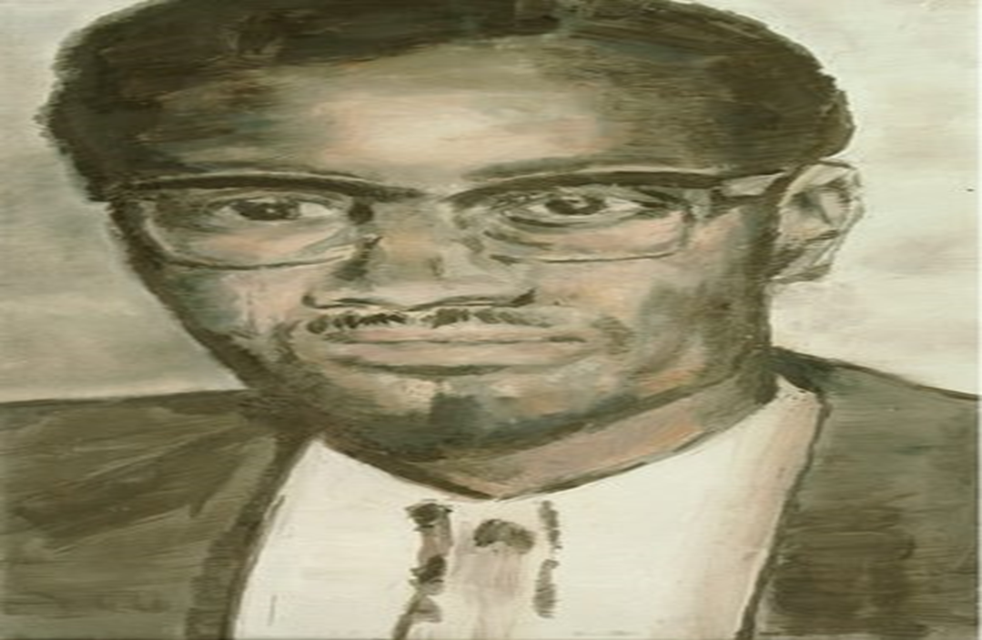
Lumumba
Notes:
Luc Tuymans did this art in 2000. Lumumba. The art is meant to provide very strong philosophical distances to historical episodes. The image is muted and dirty representing a lonely and desolate person. The image is important because it revokes the memories of the assassination of Lumumba who was Congo’s first democratically elected prime minister. The country went silent after his assassination as if nothing happened and that is why the image is deserted. The gaze of Lumumba in the image is not directed to the viewer rather away expressing alienation and detachment from people.

Slide 3
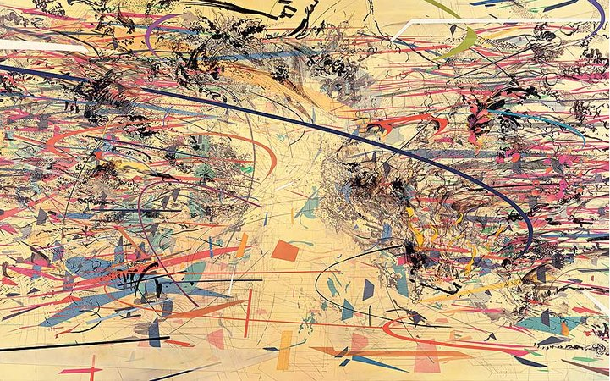
Dispersion
Notes:
The art on dispersion shows a densely layered kaleidoscopic mass of color explodes across the canvas surface. There is a clear line structure amidst the calligraphy. The image by Julie Mehretu incorporates different types of architectural designs and plans. The image represents both time and space which to the artist signify a language of the characters that existed in the post-modern landscapes. Mehretu having being born in Ethiopia does this art to show how it is important for people to identify with globalization. The art shows a connection of different cultures and races in the globalized world.

Slide 4
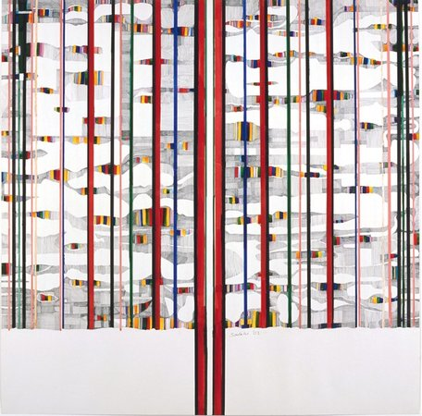
The Tree
Notes:
The art is by Ibrahim El-Salahi. The art depicts globalization and modernization. The tree represents the Haraz tree which grows in River Nile. According to the image, the tree is a typical representation of the Sudanese culture that flourishes only in the dry season yet in the wet season the tree loses its leaves. However despite the rigidity of the tree, it is slowly softened. People might be holding their cultures so rigidly but as the world becomes a global village this rigidity is slowly softened and different lines signifying integration emerge.

Slide 5
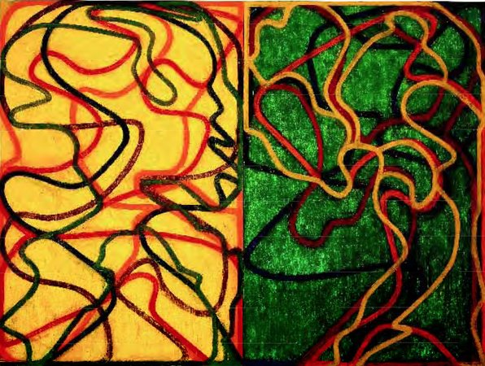
The Event
Notes:
The art by Brice Marden shows some serpent like lines that are moving in a certain rhythm across a surface of a canvas. The lines seem to be pushing up against the edges of the rectangular panels. The uncoiling ribbon like-like forms insinuate some tension. The overlapping colors do not at any point intertwine. The art represents some set of composed rules and structures that are different and oppose each other. However, the rules and the systems are equally competing for existence and that is the reality of life today. Characters and systems are different but they equally compete for existence.

Slide 6
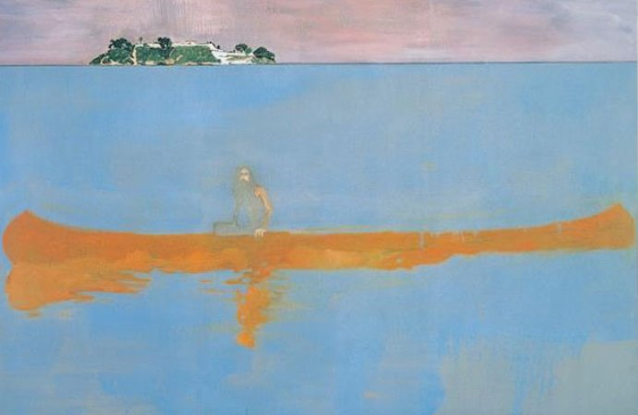
One Hundred Years Ago
Notes:
A man with long beard is seen on the image. He sits in a canoe and seems to be looking at the viewers. He is in the sea yet the sea looks very still and with some pink color. There is also an island on the horizon. The man seems bothered and exhausted. He is in the middle of the sea all by himself. Could the man have travelled from the island? Would he travel such a long distance to come and get stranded alone or was he forced to? The art signifies how sometimes people can be forced into situations that they cannot get themselves off. To the artist Peter Doig, the art reminds him of his upbringing in Canada where artists were imprisoned in an island off the Coast of Trinidad. The image signifies some form of imposed desperation. Today in this era just as it used to happen in history, there is still some forced imprisonment.

Slide 7
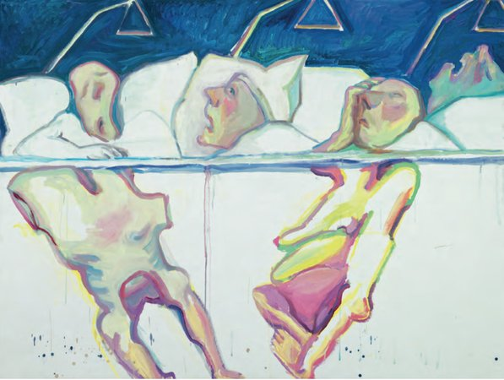
The hospital
Notes:
The art depicts a body-awareness image. The artist Maria Lassing,wanted to elaborate how one can express their physical feelings in an external way that shows their internal perceptions. The art shows images of people who seem strained and probably hurting. The feeling looks like that of being pressed by a hard chair. The three heads on the pillows show some pain and fear. This is how desperate patients lie in hospitals when they are pressed hard by sicknesses and infections and they seem not to be recovering. The art is important to the artists as it reminds her of her old age when she was sick and desperate in hospital. Similarly the art is important in helping people understand the pain that people go through in life. Some situations are so pressing that people are left agitated and desperate with no one to save them. It is a clear depiction of life. There are pressing situations as painful as dying patients in hospitals.

Slide 8
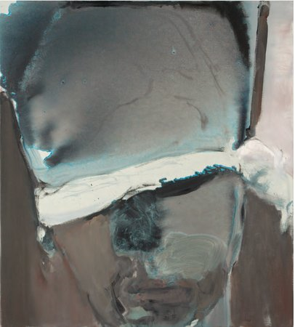
The blindfolded man
Notes:
The image of a face shows a man who has been tortured. The author Marlene Dumas,wants to portray how politics has cost some people. The man’s torture has resulted from his political interests. It is important to understand that different people have different political interests. One person therefore disagreeing with another’s political preferences should not be a source of torture or conflict as each person has a freedom of choosing their own interests and political parties. However, from time back in history, there has been a misuse of the political power where those in political power torture those who differ with their political interest. The art is therefore a lesson of how political power is misused.

Slide 9
References
Artspace Editors (2015). Twelve masterpieces of 21st Century Painting You Need To Know.

